Slide 1
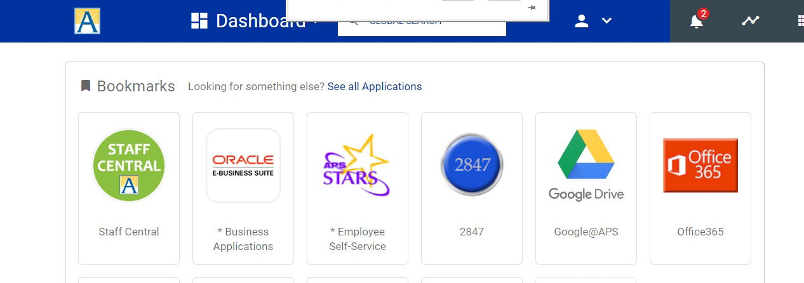


How to Add a Microsoft Office 365 SharePoint Site
This video will show you how to search for a sharepoint site
and add it to your following list.

